Slide 1
Notes:
Lesson 5
The aim in this lesson is to follow up on how it is going with the community and the class culture, as well as round up the partnerships.
All rights reserved. Reproduction of the material without Ventilens written consent is not permitted according to applicable Danish copyright law, © 2017 Ventilen Danmark

Slide 2
Class culture II
Content
Speed-meeting
Horseshoe and the ideals
Ending the buddy program
Notes:
2 min.
Go over the program. You will re-examine the class culture and very specifically look at how it is going trying to live up to the ideals. Finally, you will conclude the buddy program.

Slide 3
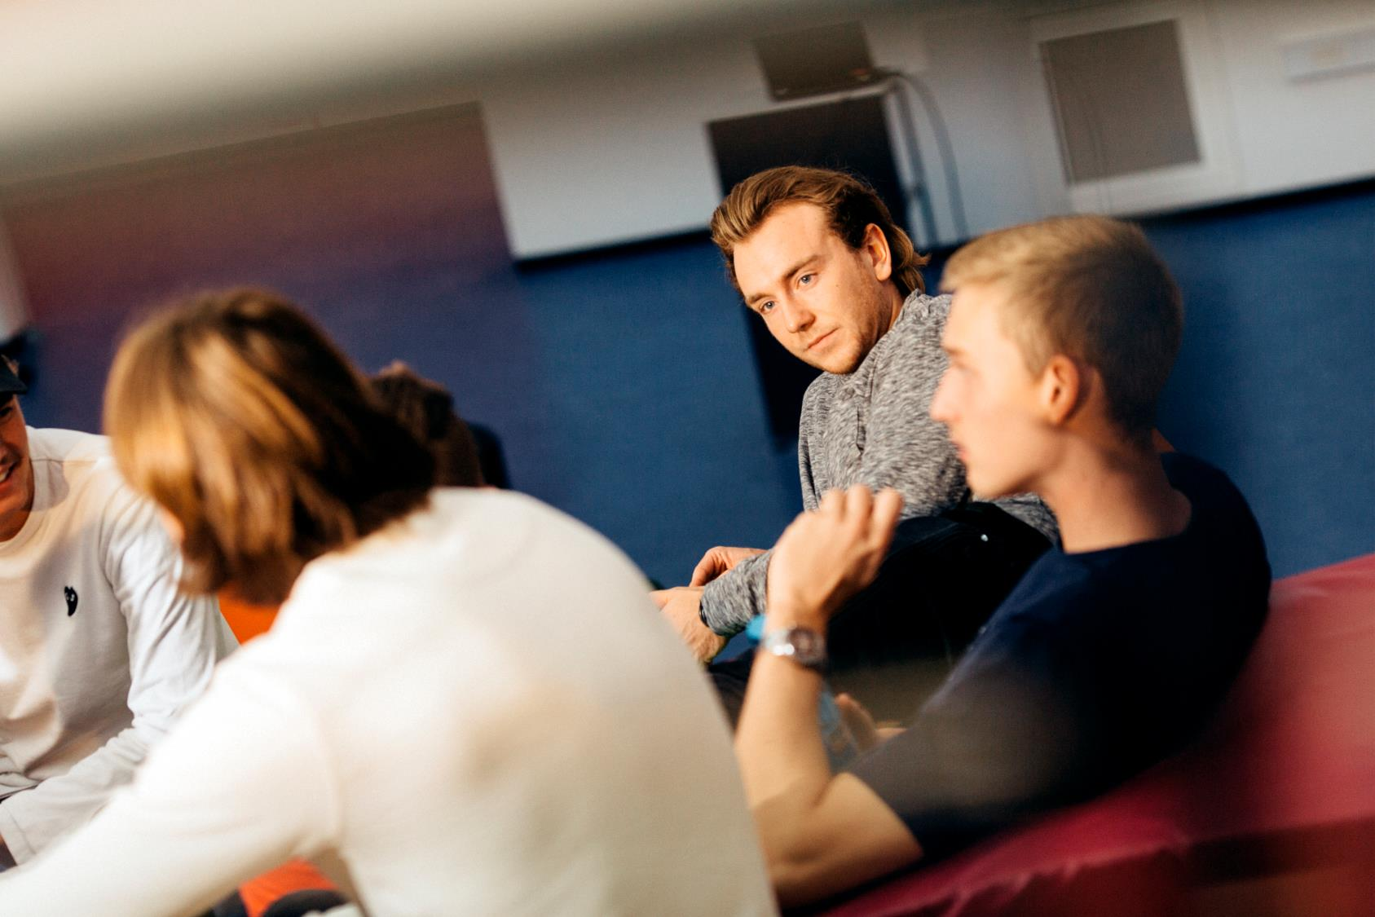
Speed-meeting about community
Notes:
15 min.
The goal of the speed-meeting is that the students are made aware of the different perspectives on community and on what a good or bad community is.
Description:
The students stand on the floor. Everyone receives a piece of paper with questions on it. The sheet of questions can be found in the description of speed-meetings (community)
The students move around each other on the floor and pair up with a random classmate. Taking turns, they will ask each other their questions. The questions can only be asked when everyone has found a partner. If there is an odd number, a group of three should be formed.
When both students have answered each other’s questions, they trade their paper of questions and find a new classmate to ask. They will ask the questions that they have just answered to the next one they meet.
The activity will go on app. 10 minutes. The idea is not that everyone should speak to everyone, but that everyone must speak to someone. As soon as someone becomes ‘available,’ they must put their hand up so others can see that they are ready for a ‘short meeting.’
Round off the activity by spending 5 minutes as a class summing up what the students have answered to some of the questions on the sheets.

Slide 4
Horseshoe and the ideals
Work with the following five ideals for the class.
‘We as a class have been good at living up to…’
[Insert one of the class ideals]
[Insert one of the class ideals]
[Insert one of the class ideals]
[Insert one of the class ideals]
[Insert one of the class ideals]
’Strongly agree’
’Strongly disagree’
Notes:
15 min.
In advance, you have written five of the ideals that the class made in lesson 2. They can be the ones you find most important (or perhaps most necessary) to return to.
You can click them on one at a time and ask the students to comment on whether they as a class have been good at living up to the ideal. They should place themselves on the horseshoe at the point they believe represents their opinion best.

Slide 5
Summary
Which two ideals do we need to work more with?
What do we need to do to better live up to our own ideals for a good class culture?
Notes:
5 min.
After you have gone over the five ideals with the help of the horseshoe, spend app. 5 minutes talking about the two ideals that most people felt the class was not living up to. What can the class/the individual student do to make the class live up to the ideal? Here it is important to discuss the reasons why we are not living up to the ideal, and not merely conclude that ‘we need to get it together!’ Consider also whether the ideal should be revised.

Slide 6
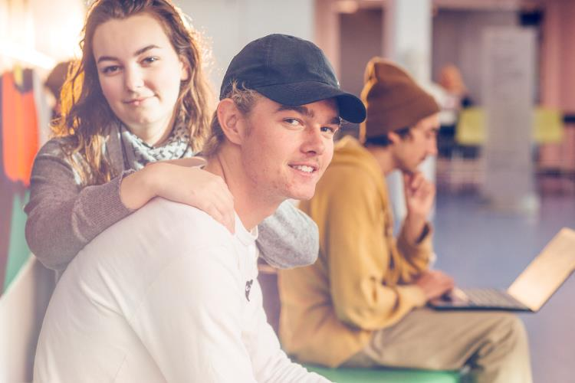
Bye, bye buddy program
Notes:
10 min.
Give the students a bit of time to talk about their thoughts on the buddy program.
The buddy groups will continue – primarily as working groups and as planning groups for the community-building activities.
Talk about what it will be like in the future. That the program may resurface in some form or another, if new students join the class. Tell them that you may also, in the future, form working groups every now and then.

