Slide 1
Notes:
Lesson 3
The aim of this double lesson is for students to know what loneliness and social languish is, so they can recognize it in themselves or a classmate, if it should arise. The more one knows about a problem, the more quickly one can get help.
It is recommended that you, before the lesson, read ‘Inspiration for playing rules during classroom discussions,’ which you can find on the website under lesson 3. Here you can find inspiration for how you can set a framework for the discussions that the students will have with each other throughout the project.
All rights reserved. Reproduction of the material without Ventilens written consent is not permitted according to applicable Danish copyright law, © 2017 Ventilen Danmark

Slide 2
Loneliness and wellbeing
Contents
Loneliness and social wellbeing
Film
Excercise
Summary
Notes:
2 min.
Go over the program for the next 90 minutes.
The first 45 minutes will be spent on a presentation, which will include a film. After that, there will be a short break.
After the break, you introduce theexercise and the students can begin the exercise.

Slide 3

Community is most important!
Notes:
3 min.
The survival of human beings depend on community. We are designed to live in groups, and our brains react instinctively if we feel that we are outside of the community.
In the animal world, we see baby penguins instinctively switching positions in the flock during a snowstorm. If they insisted on keeping their spot, the outermost chain would freeze to death, and with time, the entire flock would die. Their survival depends, quite literally, on the community.
http://politiken.dk/viden/ECE1298398/forskere-har-opklaret-det-store-pingvin-mysterium/
It is not quite so literal with humans, although newer studies have shown that enduring loneliness can lead to an earlier death. We will return to that point.

Slide 4
Everyone knows the feeling
Social insecurity/
tension
Not thriving socially
Loneliness
Notes:
5 min.
Social insecurity:
Everyone knows the feeling of insecurity or tension when one begins in a new place (school, work, sports). You want to fit in, because the social is important. You want the others to like you, to think that you say the right things, look the right way, etc.
If you want to, ask the students if they recognize this feeling. All of them will be able to.
Not thriving socially:
For some, these thoughts get stuck, and they think often about whether they fit in and what others think about them. They begin to feel uncomfortable when they are in class. This is called not thriving socially.
Loneliness:
For some, this develops into a feeling of loneliness. They begin to think that they do not belong, and that the others see them as different. They begin to think that they are not worth being around.
This social insecurity does not lead to loneliness for everyone, but it can be the beginning of a movement toward loneliness.
The point is that everyone recognizes the thoughts and feelings connected to starting in a new place. This makes it possible for students to imagine what it must feel like to have these thoughts and feelings every day.

Slide 5
Definition of loneliness
Loneliness is a feeling that occurs when one’s social relationships do not cover one’s social needs.
The relationships may be lacking in number and/or in quality.
Social needs are subjective.
Feeling lonely is not the same as being alone.
Notes:
5 min.
Relationships lacking in number:
That one does not have enough social relationships. It might be that one has a single good friend who they do not see very often – they may have started at a different school. One misses someone to ‘hang out with’ and do something social with.
Relationships lacking in quality:
That one is surrounded by a lot of people, who are probably acquaintances and may even count as friends, but who are people one cannot confide in. They are people one puts up a facade for, where everything looks good from the outside.
Not everyone has the same social needs. Two people with the same social relationships – in number and quality – can experience their situation very differently – one may feel lonely while the other is thriving.
Loneliness and being alone are not the same. Being alone can be very healthy every once in a while. When one e.g. withdraws from social activity for a moment to read a book or think some things over. Being alone is something one can choose.
Feeling lonely is never something one chooses.
Loneliness hurts and many young people feel that loneliness is embarrassing. Loneliness among youth is typically seen as very taboo.

Slide 6
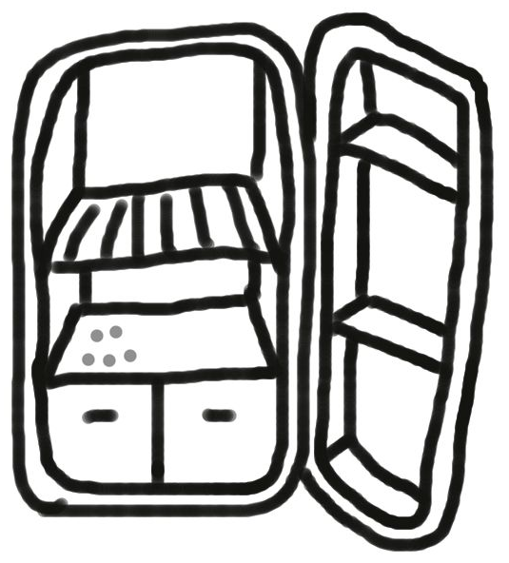
Short-term and long-term loneliness
Loneliness is a signal from the body that correspond to hunger
Short-term loneliness/hunger
Not dangerous - when calling someone or eating something, the problem is solved.
Long-term loneliness/hunger
Dangerous – when there’s no one to call or the refrigerator is empty, the problem grows.
Notes:
2 min.
One has to distinguish between short-term and long-term loneliness.
The short-term loneliness is a sign that one needs social connections. The human being is a social being and our body reminds us that we need other people, when we miss social contact. The feeling is natural and quite harmless.
But loneliness can be dangerous if it becomes prolonged. If there is no opportunity to create social contact, one’s body and brain begins to be affected by loneliness and it has a major impact on our behavior.

Slide 7
What loneliness does to us
Low self-esteem
One becomes very careful. One would rather reject than be rejected.
One’s social skills become deficient.
One begins to give up.
One’s brain begins to focus on the negative – it does not hear praise, only criticism.
Notes:
5 min.
Here we are talking about long-term loneliness.
One begins to think that one is not worth being around, so one keeps to oneself.
When one has had negative experiences in social situations – if one feels excluded or has experienced being excluded, one begins to protect oneself. One would rather reject than be rejected, so one says no to invitations.
Social skills must be trained to be maintained, just like all other skills. When one, over a long period of time, has not been part of social situations, it becomes more difficult e.g. to start a conversation, to keep a conversation going, or to read social situations.
One begins to believe that it will never change.
When the brain is on high alert (as it is when one feels long-term loneliness), it goes into self-preservation mode, and it focuses on all the negative.
The consequences of loneliness keep us in that same loneliness – we pull away from social situations in order to protect ourselves against more defeats and rejections, but it becomes a vicious circle that can be difficult to break on our own. This is why it is important to be aware of each other. If someone begins to withdraw from the community, this should raise some red flags.
It is not one’s own fault if one feels lonely. Long-term loneliness can affect our brains and shape our behavior, so we can seem rejecting, even though we would like to be part of the community.

Slide 8

The extent of youth loneliness
6-9 % of students in gymnasium feel lonely often or always.
40 % of students in gymnasiums feel lonely occasionally.
63 % have felt lonely without talking to others about it.
Notes:
2 min.
The 6 % comes from Lasgaard & Kristensen: Ensom i gymnasieskolen. Published by Ventilen in 2009.
The 9 % and the 40 % come from Ungdomsprofilen 2014, published by The State Institute for Public Health (2015).
The 63 % come from The Mary Fund’s Youth Think Tank, Loneliness, April 2015.
Ask the students what they think about the numbers – are they surprised by them?

Slide 9
Loneliness can strike anyone
Loneliness strikes both men and women
Loneliness strikes young people in the city and in the country
Loneliness strikes all types of families
Loneliness can strike out of the blue, and it can build up slowly
Notes:
5 min.
Both men and women are affected by loneliness. Some studies show that there is a slight majority of women, but the differences are not great. There is a difference in the results depending on how you ask. When mentioning loneliness specifically in the question, men generally have a lower score, but when loneloness is not mentioned specifically, there is no significant difference.
One could think that young people in the countryside were at higher risk, since they do not have as many opportunities to meet others with the same interests. On the other hand, there is a common notion about life in the country ‘that everyone knows everyone.’ That cannot be said of life in the city, and one could imagine that young people in the city more easily ‘disappear into the masses.’ Neither notion is correct – there is no difference. There are just as many lonely young people in the country as in the city.
There are no socio-economic factors that influence loneliness among youth. Loneliness can strike young people in families where the parents have good educations, good jobs, and good finances. And loneliness can strike families where parents are uneducated and have lost their jobs.
Loneliness can strike out of the blue – parents’ divorce, illness, death in the family, moving to a new town. It can also build up slowly if one, for example, is bullied or is excluded.
Now to the film, where the students will meet different experts on loneliness – including some young people themselves.

Slide 10
Film
[insert link]
Notes:
15 min.
Here you will show the film on loneliness that is a part of the material for lesson 3.
Before the video is started, tell the students that it describes how loneliness can feel and be experienced. In the film we also meet Mathias Lasgaard – the country’s leading researcher within youth loneliness, who explains what characterizes young people who feel lonely and what the consequences of loneliness can be. After that, we meet Ventilen – the organization behind Netwerk, which daily works with young people who feel lonely. A representative from the organization will talk about what one can do for young people who feel lonely.
After the film, the students must have time to ask questions. It is recommended that you in advance read the chapter on loneliness in the teaching manual. If there are questions you cannot answer, you can encourage the students to contact Ventilen.
If the students do not themselves take initiative, you can take a starting point in the document with suggestions to follow-up questions. The document can be found on the website under lesson 3.
Give the students a short break and make them come back so you can introduce the group work before getting them started

Slide 11
Personal stories and discussion
Group work in buddy groups: discuss the personal stories about loneliness
Notes:
35 min.
Hand out the sheet with working questions for the three tasks. You may not have the time for the students to do all three tasks, so make sure to let them know which groups should focus on what.
Show them where they can find the films with Martine and Kasper.

Slide 12
Conclusion
Team up with your buddy and talk about the points of loneliness, you find most important.
Notes:
15 min.
After the discussions, it is important to pick up the points of lesson 3. First you can ask the students to share some of the points from their discussions.
Afterwards, you ask the students to reflect on the two main points from the lesson and discuss it with the person next to them. Leave the task on the screen.
You end the lesson by mentioning the following points, if the students do not mention them:
Between 6% and 9% of students in upper secondary educations have said that they often or every day feel lonely.
Loneliness and social languish can strike everyone.
Young people who feel lonely can get help to come out of the loneliness.
Most young people will during shorter periods experience the feeling of loneliness, and it is rather natural, but a long-term or returning feeling of loneliness can have great health-related and social consequences.
Everyone feels happy to be invited along to something – not all want to participate, and some do not have the courage to say yes.

