Slide 1
Notes:
Lesson 1
The aim of this lesson is to give the students an impression of Netwerk to prepare them for the program, how long it will last, as well as to establish the partnerships and partnership groups.
All rights reserved. Reproduction of the material without Ventilens written consent is not permitted according to applicable Danish copyright law, © 2017 Ventilen Danmark

Slide 2
Netwerk
- a project by Ventilen and The Mary Foundation
Contents
Netwerk’s goal
Activities
Buddy program
Exercise: ‘Meet your buddy’
Notes:
12 min.
Welcome everyone. Tell the students that you are all part of Netwerk, and that they have received a buddy, whom they are already sitting next to. Furthermore, inform the students that are also part of a buddy group with two other students.
Read the buddy pairs and groups aloud to the students. At the same time, ask the students to fill out the telephone list with their phone numbers (upload the list to the class intranet – remind the students to get their buddy’s phone number when the class is over). You will later go over the buddy program actually is.
Present the program for app. the next 20 minutes. The last 15 minutes will be spend on an interview exercise.

Slide 3
Netwerk
A project that we as [write in the class/school] are a part of.
The aim is to create strong communities and a healthy class culture with room for everyone. No student should sit in this class and feel like they do not belong.
Since strong communities and healthy class culture prevents the feeling of loneliness or being excluded.
Because social well-being and academic capacity go together – it is easier to learn and contribute in class, when you thrive socially.
Ventilen and The Mary Foundation are behind Netwerk.
Notes:
3 min.
Netwerk is a project for upper secondary educations/youth education programs that contributes to creating good communities. Talk about how many classes at the school use the methods – and which of the class’s teachers are informed and who the students should expect to be familiar with the methods of Netwerk.
Good communities make sure that everyone is a part of a whole. This school want to make sure that all students are doing well, and that is done best by including everyone in the community.
Studies show that 6-9% of students in upper secondary education feel lonely in their class – on average one or two in each class (source: Lasgaard & Kristensen (2009): Ensom i gymnasieskolen og Statens Institut for Folkesundhed (2015): Ungdomsprofilen 2014).
They do not feel that they have someone to talk to about their thoughts and feelings. You cannot see whether someone else feels lonely. They may also feel lonely, even though they are surrounded by a lot of people. Netwerk prevents loneliness by focusing on good communities with room for differences.
What Netwerk is made of more specifically, I will explain a bit later.
Ventilen and The Mary Foundation are behind the initiative. Ventilen is a youth organization that works with young people who feel lonely. The Mary Foundation is a fund by the Crown Princess Mary, which works to fight social isolation based on the idea that everyone has a right to belong.

Slide 4
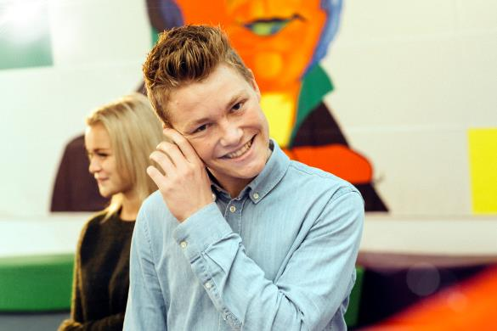
What is Netwerk made of?
Buddy program
Knowledge about loneliness and social wellbeing
Where to find help, if you are not doing well?
Class culture I, II and III
Community-building activities
Notes:
7 min.
Here you will briefly go over what Netwerk is made up of. The students will get the full explanation when you reach the lessons, but it is important that they have the elements outlined for them, so they know what to expect of the program. NOTE: If you choose to change the order of the lessons, they should also be changed here.
Buddy program:
The buddy program is a tool to strengthen the relationships in class. To make the beginning at the new school easier, prevent clique formation, forge new bonds, and avoid students only hanging out with those they already know from before. This makes the social community stronger – and if the social community is strong, it serve as a better basis for a high academic level.
Knowledge on loneliness and social wellbeing:
We know that loneliness affects a relatively high proportion of young people in upper secondary education, and we know that by raising the level of awareness about problems related to well-being, it becomes easier to get help. That means that you can find the right help faster if you – or any of your classmates – come to need it. At the same time, knowledge of ordinary well-being makes it easier to be attentive of each other – and react if someone is not doing well, instead of just thinking ”Someone else will probably deal with it” or ”They will probably ask for help themselves, if they need it.”
Where to find help?
What are you supposed to do if you or others in your class are having a hard time? On that, Netwerk will shed some insight and give you hands on-tools. Among other things, it is about knowing the opportunities to find help at school or in the local environment and about how to prevent loneliness.
Class culture I, II and III:
Culture is formed in any meeting between human beings no matter what happens. In Netwerk we focus on actively creating a good classroom culture from the very beginning. A culture where there is room for differences. In the first lesson, the class must formulate ideals for a good class culture, and there will be two more lessons where the class must discuss what works well in class and what you as a class can improve.
Community-building activities:
Class culture and good communities will be discussed in the different lessons, but to really make a difference, the students themselves must take part in creating a healthy community. The idea is to do something together that lets you get to know each other across the class – even after the introductory period is over. The students must do some team-building exercises themselves (cosy and fun things) – in Netwerk called community-building activities.

Slide 5
Buddy program
Buddies (a selection of tasks):
You sit next to each other.
You are attentive to whether or not your buddy is doing well.
You write a text message to your buddy if they do not come to school.
You work together during group work.
Buddy groups:
You do group work together, when relevant.
You represent a ‘safety net’ for each other’s buddies.
Notes:
7 min.
The idea behind buddies is not to be best friends, but to take responsibility for each other and become good classroom colleagues, as well as to make sure that there is at least one person who can check up on you.
Go over the tasks for buddies and buddy groups. Note that there are both social and academic tasks. Give out the handout to the students on the buddy program.
Tell the students that buddies and buddy groups are changed every third week until autumn break (two changes). After that, only the buddy groups will continue, and primarily as working groups. If the students have any questions, take them now.

Slide 6
Meet your buddy
Choose three questions you want ask your buddy!
What is your favorite movie?
What is your dream job?
What music do you listen to at the moment?
What did you eat for dinner last night?
Who is your role model?
What three things would you bring to a deserted island?
What is the last thing you bought?
What shoes are you wearing today?
Do you like coffee?
What did you eat for breakfast today?
What did you dream of becoming as a child?
Do you have a pet? What kind?
What is your dream vacation?
Notes:
15 min.
Here is a list of suggestions for questions. Each student chooses three questions and interviews his/her buddy. Afterwards, they must present their buddy to the rest of the class in maximum 10 seconds. E.g. ”This is Lærke. She ate potato soup for dinner last night. She dreams of becoming a journalist. The last thing she bought was a cup of coffee in the cafeteria.” The goal is not for the students to get a deep description of each other, but to make it a comfortable way for everyone to say something aloud in class– and it may be easier to present someone else to the class than to present oneself. The interviews must be very short, since there is not much time for the exercise (app. 5 minutes for the interviews and 10 minutes for the presentations), and it is important that everyone says something.
Round off by telling the students when Netwerk will be on the schedule again.

